Slide 1









ANALYZING TECHNOLOGY TRENDS
ARITRA BASU
04/03/2023
Dataset Source :
Click Here

Slide 2



OUTLINE
Executive Summary
Introduction
Methodology
Results
Visualization – Charts
Dashboard
Discussion
Findings & Implications
Conclusion
Appendix

Slide 3

EXECUTIVE SUMMARY
Contextualization of data and the goal of the analysis
Methodology Description
Capturing Current Technology Usage This Year
Top 10 Programming languages
Top 10 Databases
Top 10 Web frames
The data also shows the choices of programming languages, databases, web frames to be used next year.
Top 10 Programming languages
Top 10 Databases
Top 10 Web frames
Classification on respondents in terms of
Age
Gender
Education level
Geographic Location

Slide 4

INTRODUCTION
Stack Overflow’s survey that happened in 2019 collects a huge number of people’s responses who code or are related to coding all over the world
Data collected does not represent all of the people who code around the world
It represents people based on their responses
It differentiates the sample of the survey based on gender, country of origin and their job roles
Analyzing the current usages and trends in terms of programming languages, databases, web frames.
Purpose of Analysis
Analyzing factors like age, gender and geographic locations in the IT sector
Analyzing the demand of skills in the IT industry
Determining the future requirements in this industry
Target Audience
Hiring Managers
Software Engineers
Developers

Slide 5

METHODOLOGY
DATA COLLECTION
MODIFIED STACK OVERFLOW SURVEY DATASET
WEB SCRAPING
APIs
DATA EXPLORATION
SEEING TRENDS THROUGH DATA
EXPLORATORY DATA ANALYSIS(EDA)
DATA DISTRIBUTION
CORRELATION
FINDING OUTLIERS
DATA VISUALIZATION
IBM COGNOS
DATA PRESENTATION
MICROSOFT POWERPOINT

Slide 6
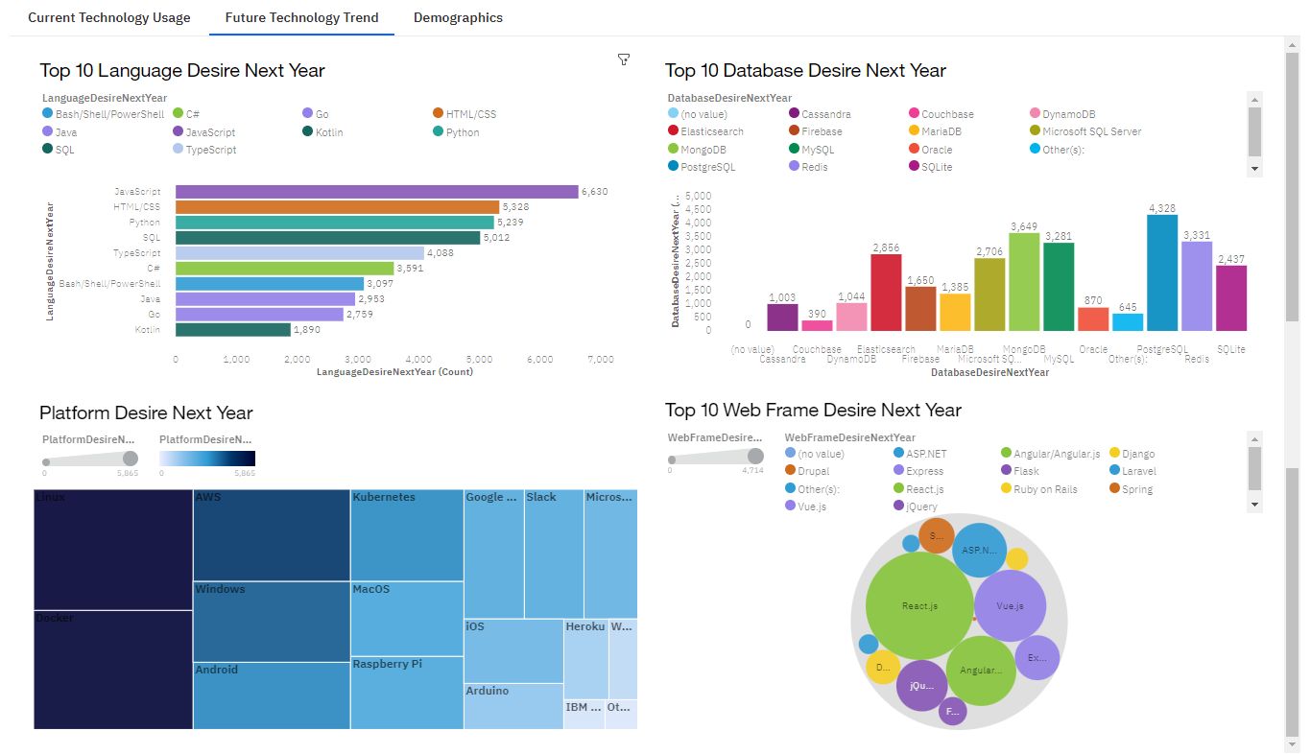
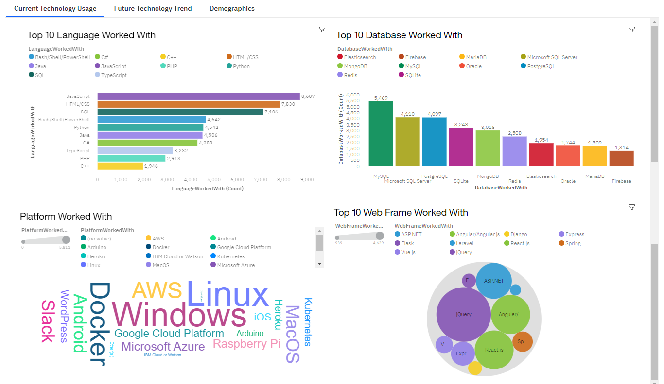
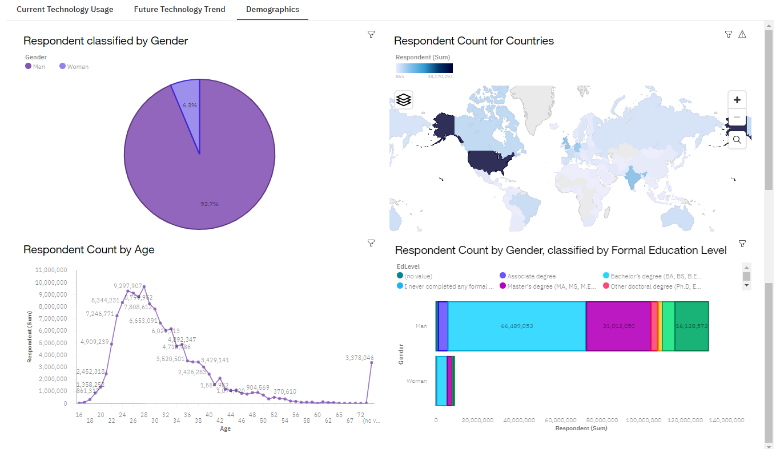
RESULTS

Slide 7
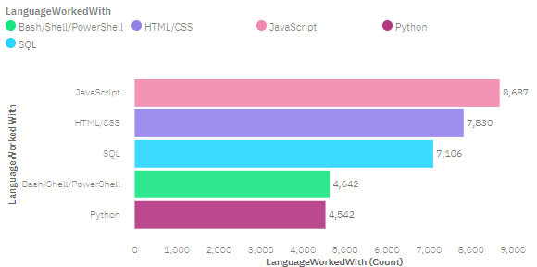
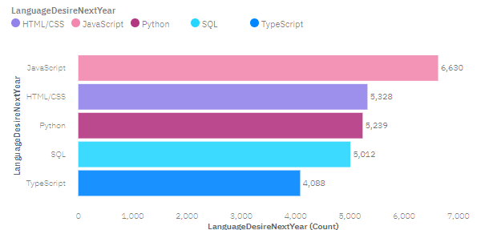
PROGRAMMING LANGUAGE TRENDS
Top 5 Programming Languages for Current Year
Top 5 Programming Languages for Next Year

Slide 8
PROGRAMMING LANGUAGE TRENDS - FINDINGS & IMPLICATIONS
Findings
Java Script is the most used Programming Language and will be so next year too
HTML/CSS will retain the second spot next year too and PowerShell will not be in top 5
Python is gaining popularity and will become third most used Programming Language
TypeScript will enter the top 5 next Year
Implications
As Data Science, ML and AI is expecting to grow, Python will be more in demand following next year
PowerShell users will have to upskill themselves in terms of the demand of the industry
Web and Software developers will be in demand as Java Script and HTML/CSS will rule the IT sector

Slide 9
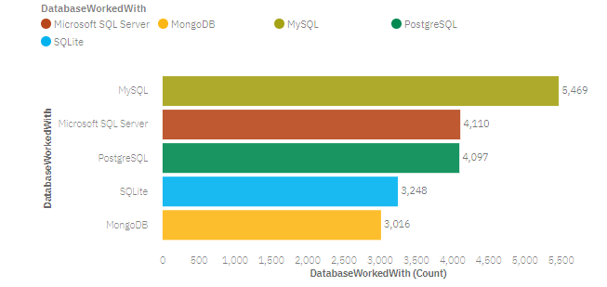
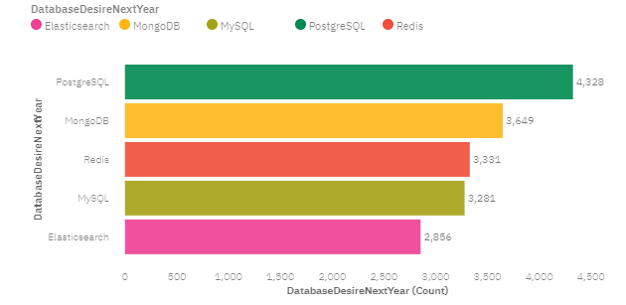
DATABASE TRENDS
Top 5 Databases for Current Year
Top 5 Databases for Next Year

Slide 10
DATABASE TRENDS - FINDINGS & IMPLICATIONS
Findings
MySQL is at the top this year and it will be in top 5 next year
PostgreSQL is in top 5 but will be at the top next year
Microsoft SQL Server and SQLite are there in the top 5 this year but their demand will decrease that will not keep them in the top 5
MongoDB is in top 5 but will jump to 2nd spot next year
Implications
MySQL will still be in use in vast areas
Databases are important for Data Science and Back End Development and so they will continue to be in demand
Big Data is taking over the sector and so NoSQL databases are become and will be in demand following next year

Slide 11


DASHBOARD
The permanent link of the read-only view of the Cognos dashboard
CLICK HERE

Slide 12
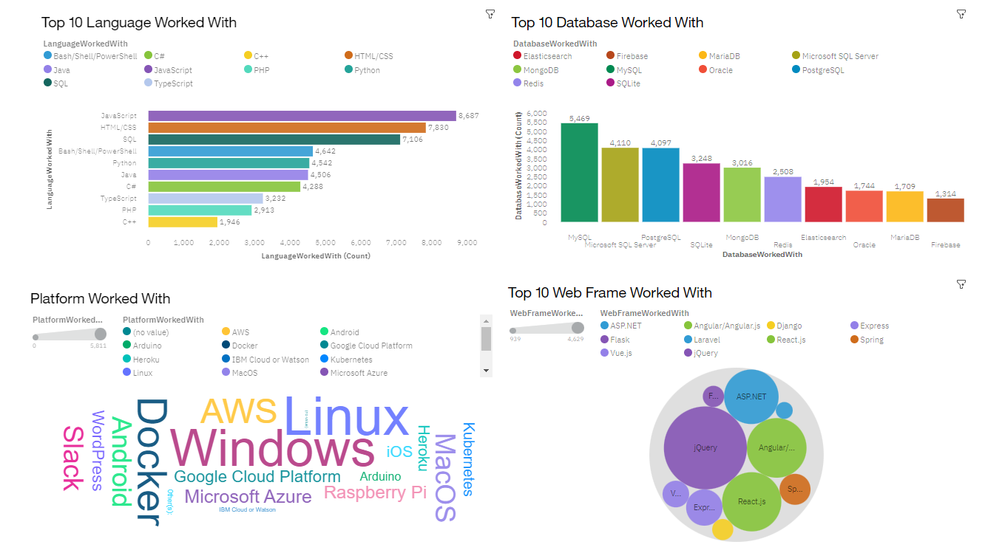
CURRENT TECHNOLOGY USAGE

Slide 13
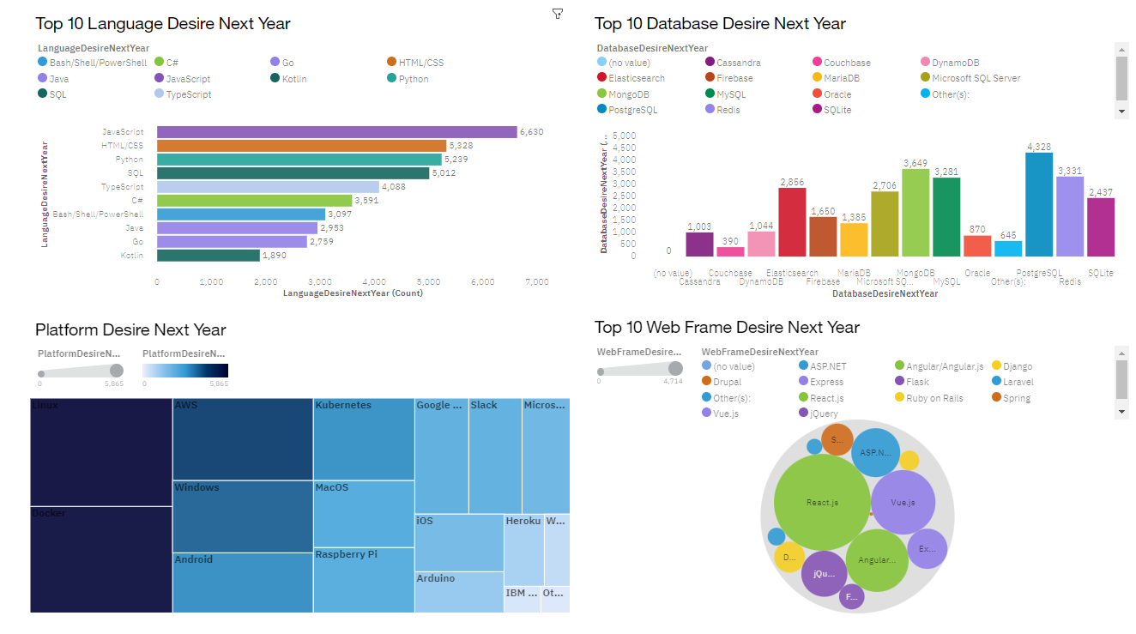
FUTURE TECHNOLOGY TRENDS

Slide 14
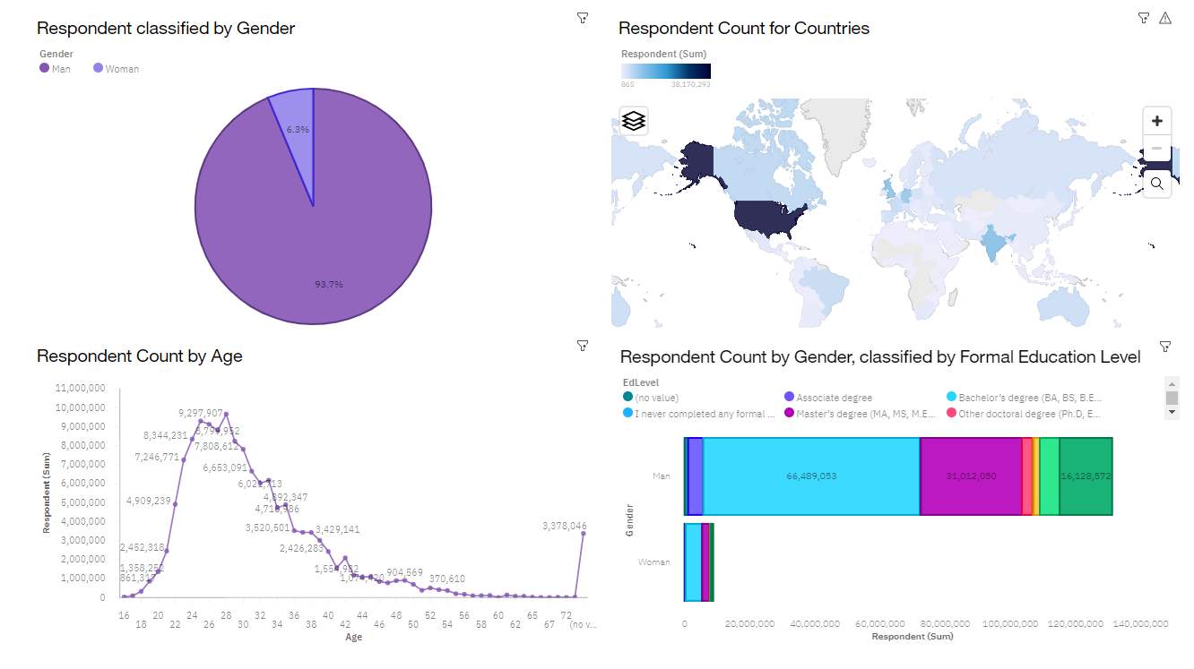
DEMOGRAPHICS

Slide 15
DISCUSSION
CURRENT TECHNOLOGY USAGE AND TRENDS IN THE IT INDUSTRY
PROGRAMMING LANGUAGES
DATABASES
PLATFORMS
EDUCATION LEVEL, AGE, GEOGRAPHICAL BIASNESS IN IT SECTOR

Slide 16
OVERALL FINDINGS & IMPLICATIONS
Findings
90% men working in the IT industry that indicates gender based discrimination
Technology will keep evolving and the demand will be higher in future
As Big Data is increasing enormously, NoSQL databases will be in high demand
Some languages like Python, HTML/CSS and Java Script will be in top of the list
Implications
United States has developed their IT industry enormously and other countries should also follow the path od the United States
There will be a huge change in terms of programming languages, databases and web frames and so developers should upskill themselves
In terms to grow, the sector needs to reduce the discrimination in terms of gender

Slide 17

CONCLUSION
A good understanding of current usage and future trends in the IT industry is obtained
The growth suggests that developers and other people associated with programming and big data need to upskill and leans other technologies
Discrimination is the main reason in some countries that can halt their advancement in the IT sector
Big Data and NOSQL databases will play a big role in the IT industry and will play a huge role in terms of growth of the sector
There is no monopoly of languages or platforms in the sector and more leaning two to three of them(programming languages, databases, web frames) is suggested

Slide 18

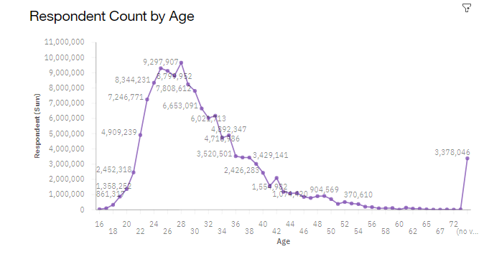
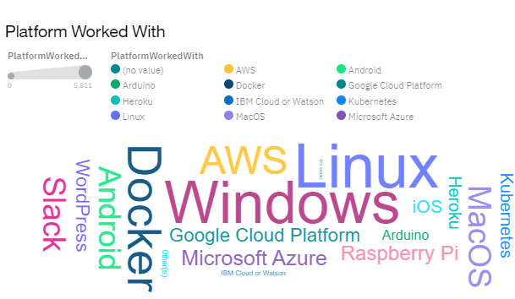
APPENDIX

Slide 19
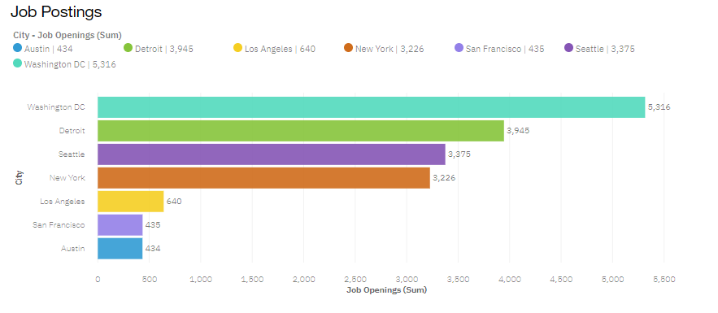
JOB POSTINGS

Slide 20
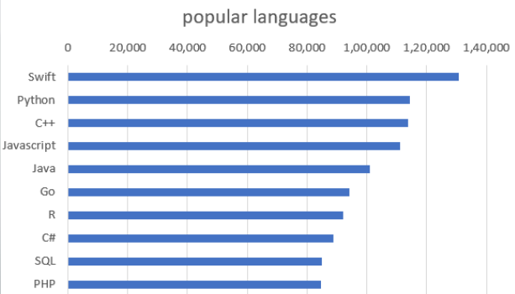
POPULAR LANGUAGES

